Slide 1
Economic Impact Payments (EIP)

Slide 2
Welcome

Slide 3
Economic Impact Payment (EIP) Assister Guide
Congratulations on being named (or choosing to be) an EIP assister!
Your work will help low-income non-filers receive payments they are eligible for.
This guide provides background on EIPs, outlines the steps to assist others with completing the form, and has a list of additional resources to help you help others.

Slide 4
Background

Slide 5
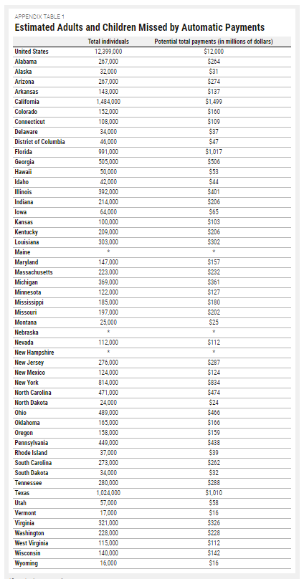
Who is Missing Out?
About 12 million Americans risk missing out on Economic Impact Payments – sometimes called “stimulus checks” – provided through the recent CARES Act.
They, unlike millions of people who are receiving the payments automatically from the IRS, must file a form by November 21st to receive it this year.
Together they represent $12 billion in payments that can stimulate state and local economies.

Slide 6
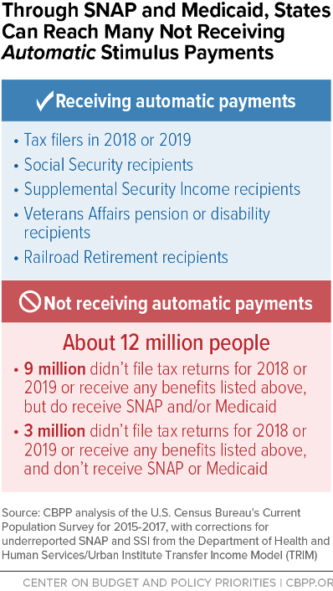
Reaching Non-Filers
The target population includes very low-income and individuals and families -
9 million of whom likely participate in TANF, SNAP, and/or Medicaid.
Of the 9 million:
3.2 million are under age 17
40% are adults without minor children (many under 25 as well as those between 50-65)
Many are likely people without secure housing

Slide 7
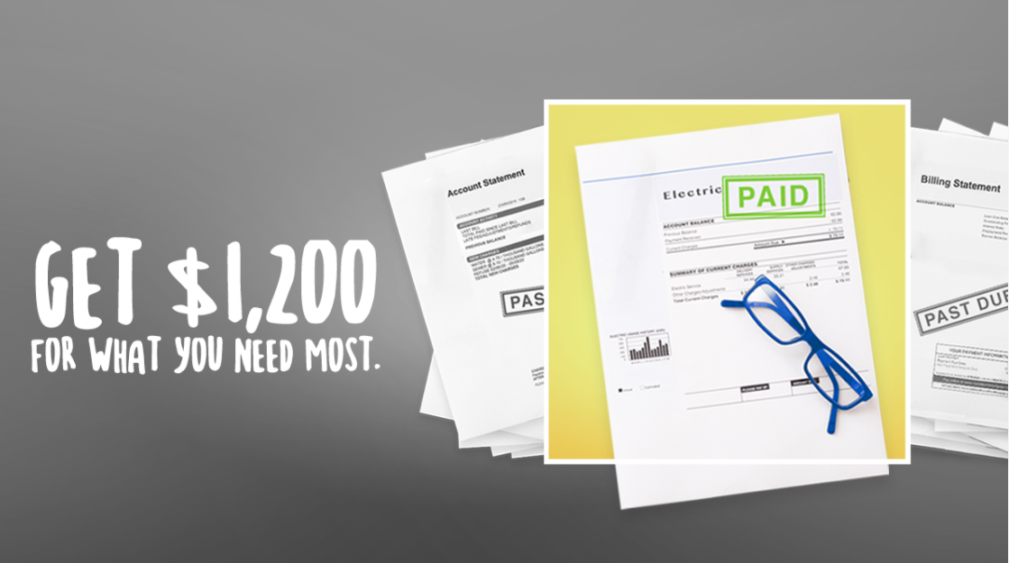
Who Automatically Receives an EIP Check?
Those who filed taxes in 2018 or 2019
Recipients of:
Social Security
SSI
Disability
Veteran’s Pension
Railroad Retirement

Slide 8
Filing Deadline
Eligible individuals have until
November
21
to file for their EIP to receive payment this year.

Slide 9
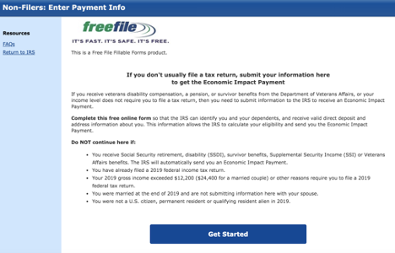
Why You?
You have the access and power to help individuals who get SNAP, Medicaid, and TANF receive their stimulus checks.
The payments can help your local economy in an uncertain time.

Slide 10
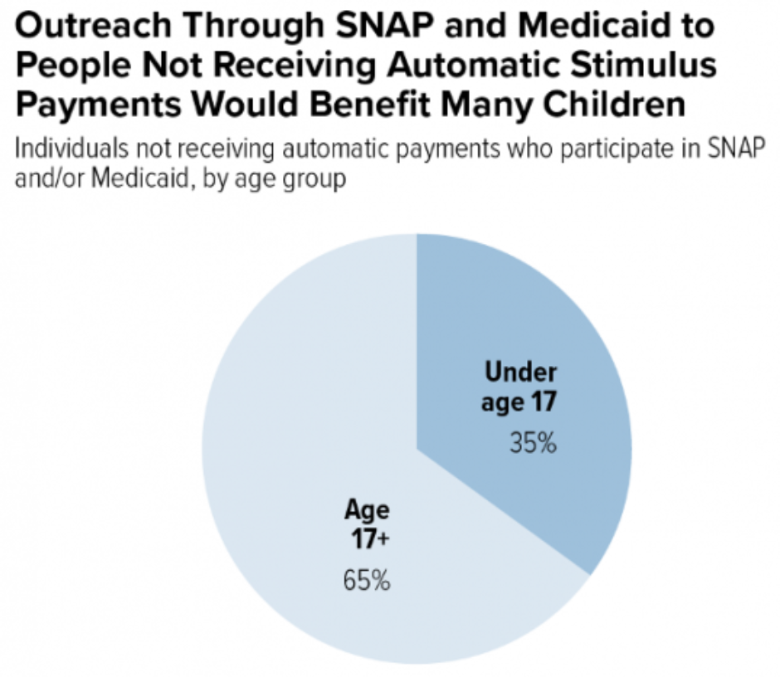
Who Should You Look For?
Very low-income individuals
All recipients of federal and state cash assistance programs
Individuals without secured housing (homeless)
People who are chronically unemployed
Low-income adults without minor children / ABAWDs
Children 17 and under

Slide 11
Completing the Form

Slide 12
Getting Started
The Non-filer form takes 10-20 minutes to complete. There are options to complete the form in both English and Spanish. These instructions are for the English form.
To complete the form, you will need the following:
A computer or mobile device with access to the internet
Note: the form does not resize on mobile devices. You’ll need to scroll right and left to complete all the form fields.
Client’s Full Legal Name
Client’s Social Security Number
Client’s Date of Birth
Client’s Email Address

Slide 13
Recommendation
If you’re able, please open the form (link on next slide) in a separate window while going through this presentation so you can see what it looks like on screen.

Slide 14
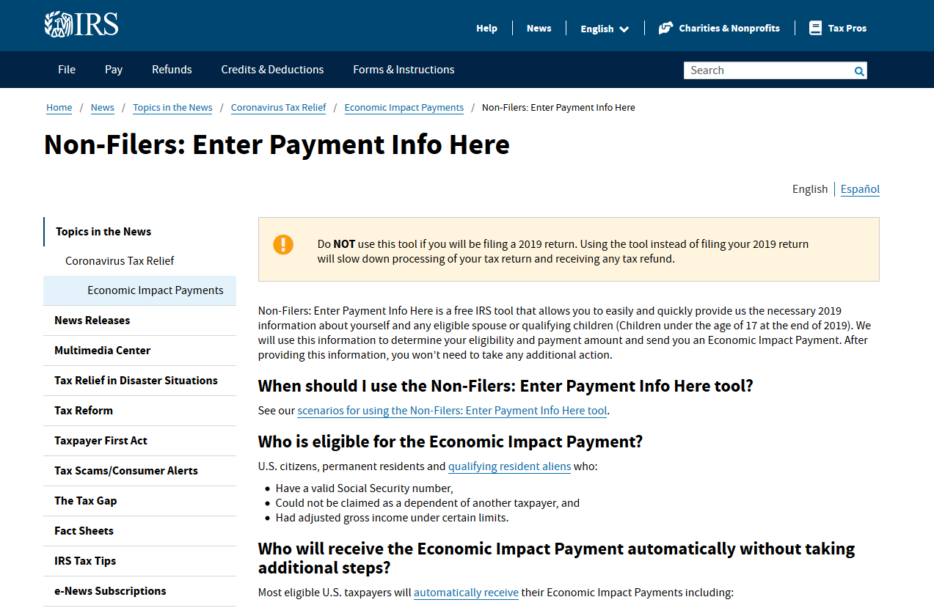
Step 1: Visit the IRS website to access the Non-filer form.
Scroll down on this page: www.irs.gov/coronavirus/non-filers-enter-payment-info-here

Slide 15
When you see the options for completing the form, click the blue “Enter your information” button:

Slide 16
You will be taken to this page: https://www.freefilefillableforms.com/#/fd/ EconomicImpactPayment
Click the blue “Get Started” button after reviewing this page to make sure your client meets all criteria to use the form.

Slide 17
Step 2: Create an account.
Fill out the information to create an account.
Email address: use an email address that your client has access to. Your client will need to check their email to verify their address before submitting the form. (If your client doesn’t have an email address, they can create a new email address for free through a webmail provider like Gmail, Yahoo!, Mail, or AOL. Links to set up free webmail accounts can be found in the resources section on slide 37.)
User ID: your client should select a user ID that they will remember, that they don’t use for something else, and that doesn’t include personal information.
Phone number: while not required, it is recommended and can be used to help your client access their account if they forget their password.
Password: requires both upper- and lower-case letters, 8 characters, a number, and a symbol. Have your client choose a phrase that they can remember or write it down in a secure place.

Slide 18
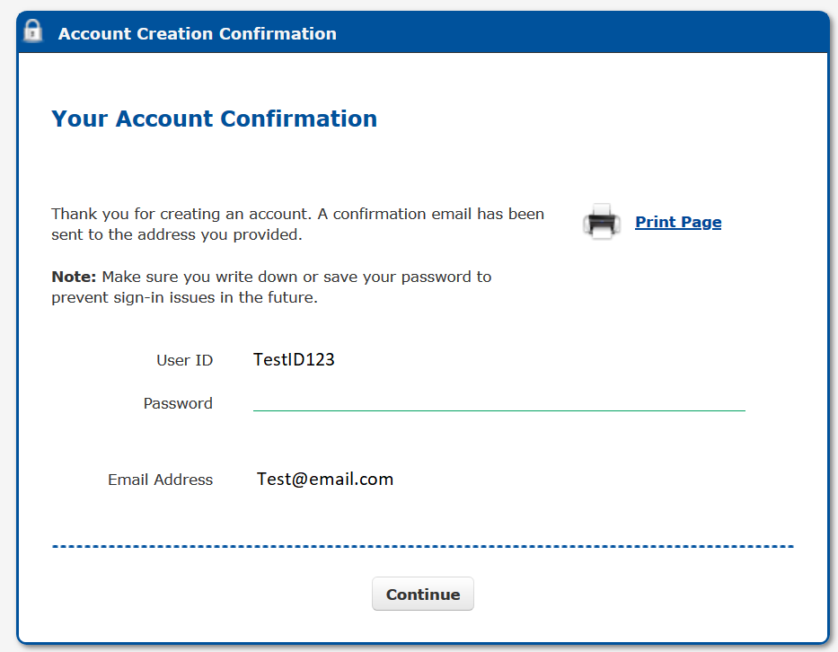
Once you complete the form and click the blue “create account” button, you will see this account confirmation page:
Hit the “Continue” button to begin completing the form.

Slide 19
Note: If you don’t use the form for 20 minutes, it will time out and you will see this message:

Slide 20
Step 3: Fill out filing status, claim dependents, and provide banking information.
For “STEP 1. Fill Out Your Tax Forms,” there is required and optional information to complete. Skip the optional fields if they do not apply to your client.
Required:
Filing Status (Single or Married filing jointly)
First name, middle initial, and last name
Social Security Number (SSN)
Home address
Note: these fields are required for your client and their spouse if they are married filing jointly.

Slide 21
Optional Info
Dependents:
Check the box if your client or their spouse can be claimed by someone else as a dependent
First and last name, SSN, and relationship of any qualifying dependents that your client has
Bank account routing info
Direct deposit is the quickest and safest way to get payment. If your client doesn’t have a bank account, they can still get their payment through direct deposit using a prepaid debit card, payment apps like CashApp, Venmo, or PayPal, or opening an online bank account. If they cannot use these options, they’ll get their payment as a paper check.
Identity Protection PIN
Only include if the IRS provided your client a number because they’ve experienced identity theft.
After entering all the information that relates to your client, click “Continue to Step 2.”

Slide 22
Step 4: Fill out income and personal identification information.
“STEP 2 E-file your tax forms,” requests both required and optional information.
Required:
Personal verification:
The form asks for AGI, or adjusted gross income, which is your client’s income minus certain payments, like student loan interest, that won’t be taxed.
If your client did NOT file taxes in 2018, enter “0” in the box for “Last year’s AGI.” Ignore part B which asks for last year’s self-selected signature PIN.
Date
Electronic signature: Instead of your client signing their name, their signature is a 5-digit PIN number that they create.
Date of birth
Note: these fields are required for your client and their spouse if they are married filing jointly.

Slide 23
Optional Info
Cell phone number
Driver’s license or state issued ID number, state, issue date, and expiration date – leave blank if your client (or their spouse if married filing jointly) doesn’t have one

Slide 24
Step 5: Verify email address.
Before you can submit the form, your client must verify their email address. “Click the Update Your Account” link.

Slide 25
A box will open on your screen that looks like this:
Click the “verify email” link that appears next to your client’s email address.

Slide 26
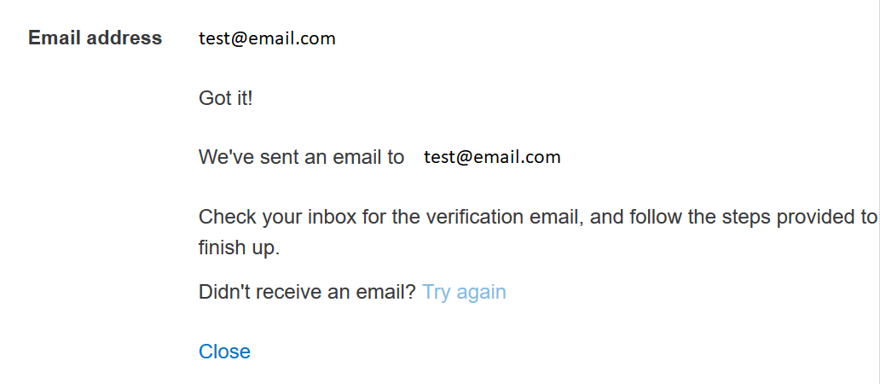
Click the blue “send verification email” box:
Have your client check their email.

Slide 27
They will receive a message from the sender “Non-Filers Enter Payment Info” with the subject line, “Your Non-Filers: Enter Payment Info – Account”. The message will look like this:
Have your client click the “confirm my account’s email address” link.

Slide 28
This screen will open:

Slide 29
Close the Email Verification window and return to the “Update your account” screen and click exit.

Slide 30
This will take you back to the form. Now your client’s email address should show as verified:

Slide 31
Step 6: Submit Form.
Click the blue “Continue to E-file” button.
If you’ve entered all the necessary information, you’ll be directed to a captcha verification page. Once you fill that in, you should be able to file your client’s form. The IRS website states:
You will receive an e-mail from Customer Service at Free File Fillable Forms, a trusted IRS partner, that either acknowledges you have successfully submitted your information, or that tells you there is a problem and how to correct it. Free File Fillable forms will use the information to automatically complete a Form 1040 and transmit it to the IRS to compute and send you a payment.

Slide 32
Worker Scripts

Slide 33
Worker Scripts for EIP Assistors
As you’re looking through a case and you believe that your client may fall into the non-filer category, you may choose to contact them with more information about EIP.
Boilerplate language has been developed to make this easier, including:
E-mail
SMS
Voicemail
You can find the scripts at: https://www.cbpp.org/stimulus-payments-outreach-research.
Scroll toward the bottom of the page to “Caseworker Scripts for Assisters” to download a Word copy.
Worker FAQs can be found in the same location (above the scripts).

Slide 34
Additional Resources

Slide 35
Resources
Free File Fillable Forms FAQs
https://www.freefilefillableforms.com/#/fd/eip.faqs
Provides more guidance if your client needs help with the Non-filer form
United Way’s 211 Economic Impact Payment Helpline
1-844-322-3639
Operates 24/7 with live agents available 8 am – 8 pm ET M-F through November 21, 2020.
Refer clients to for help filing out the form in addition to (or instead of) referring to your community partner.
IRS Economic Impact Payment Information Center
https://www.irs.gov/coronavirus/economic-impact-payment-information-center
IRS tool to check the status of payment delivery
https://www.irs.gov/getmypayment
Volunteer Income Tax Assistance (VITA) site locator
https://irs.treasury.gov/freetaxprep/
Some sites may offer help for non-filers to sign up for their EIPs.
IRS EIP Hotline
1-800-919-9835

Slide 36
Free Webmail Account Set-Up
Visit one of the sites below for the webmail provider your client wants to use.
Enter their name, the username they’d like (if the username is already taken, some sites will offer alternatives), create a password, enter required information (e.g. phone number, birthdate, gender, etc.) have client review terms and agree or decline.
Google: https://accounts.google.com/signup
Yahoo!: https://login.yahoo.com/account/create
Mail: https://signup.mail.com
AOL: https://www.aol.com/ - then click Login/Join, then click Sign Up at bottom of screen.

Slide 37
Thank You!
Thank you for doing your part in helping low-income individuals access the stimulus payments for which they are eligible.
And for all the work you do every day to provide valuable benefits and resources to people in need!

